Slide 1
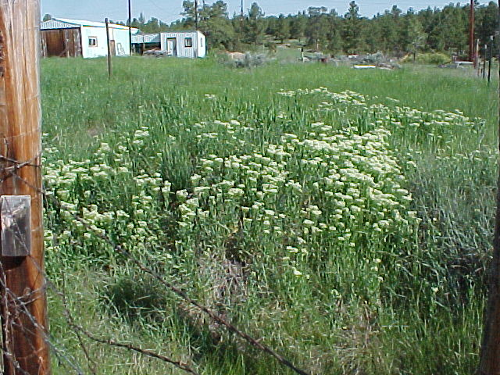
Noxious Weeds

Slide 2
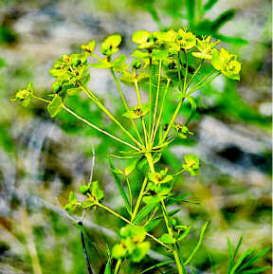
What is a Noxious Weed
A weed that was defined by law as being especially undesirable, troublesome, or difficult to control

Slide 3
Why Fight Weeds
Devalue land
lose vegetation
lose soil
lose water quality
Cost to control
chemical
labor

Slide 4
Montana Noxious Weed Law

Slide 5
Montana Noxious Weed Law
MCA 7-22-2116
Unlawful to permit noxious weeds to propagate
It is unlawful for any person to permit any noxious weed to propagate or go to seed on his land
except that any person who adheres to the noxious weed management program of his district
who has entered into and is in compliance with a noxious weed management agreement

Slide 6
Am I In Compliance
Do you have noxious weeds on your land?
Do any of those weeds go to seed?
Are you trying controlling all those weeds?
Do you have a weed plan?

Slide 7
County Process
Weed complaint filed
Confirm if weeds are there
Send an informational letter
Hope for weed plan
Fulfillment of Plan
Violation Letter
County Attorney Letter
County sprays land

Slide 8
Cooperation/Neighbor

